Slide 1
Sistemi za upravljanje bazama podataka Interna struktura i organizacija indeksa kod MS SQL Server-a
Doc. Dr. Aleksandar Stanimirović
Nemanja Raković 590

Slide 2
Uvod
Potrebe za RDBMS sistemima
MS SQL Server
Osnovni koncepti skladištenja
Buffer pool
Forwarding pointer
Heap tabele
B-stabla

Slide 3
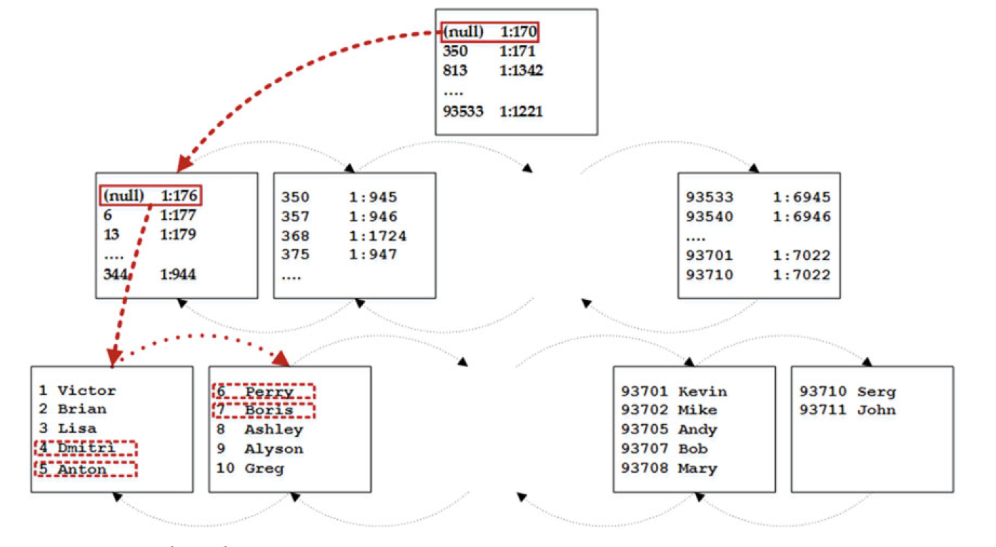
Klasterovani indeksi
Index ordered scan
Allocation ordered scan
Index seek
Point-lookup
Range scan
Unique
Static, Narrow
Ever-increasing
PK constraint
create clustered index IDX_Customers_CustomerId on dbo.Customers(CustomerId)

Slide 4
Neklasterovani indeksi
Indeks na kraju knjige
Logički rid
clustered rid
file:page:slot
Selektivnost!!!
Query planner
Presek
Unique c.
create nonclustered index IDX_CustomersID_NCR on dbo.Customers(CustomerId)

Slide 5
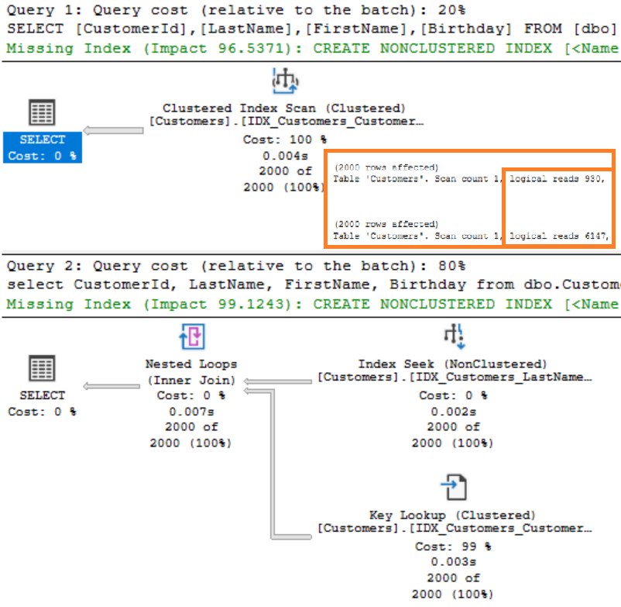
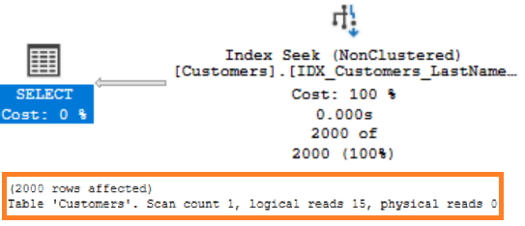
pokrivanje upita, filtirianje
create unique clustered index IDX_Customers_CustomerId
on dbo.Customers(CustomerId)
create nonclustered index IDX_Customers_LastName_FirstName
on dbo.Customers(LastName, FirstName)
select CustomerId, LastName, FirstName, Birthday
from dbo.Customers
where LastName = 'Anderson’
create nonclustered index IDX_Customers_LastName_FirstName_BirthdayIncluded
on dbo.Customers(LastName, FirstName)
include(Birthday)

Slide 6
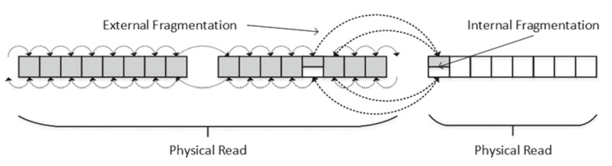
Fragmentacija i održavanje indeksa
Podela stranica
Fragmentacija
Interna i eksterna
Interna – za i protiv
FILLFACTOR
sys.dm_db_index_physical_stats
Reorganizacija
Rekreiranje

Slide 7
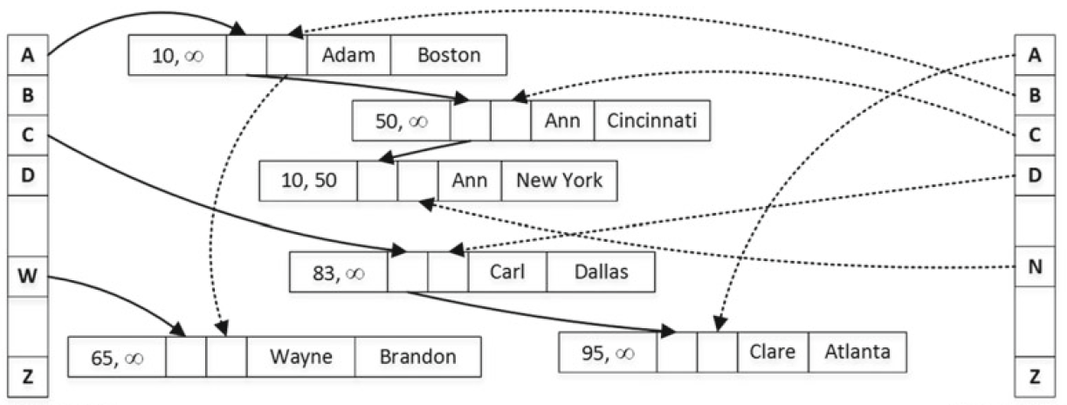
In-memory hash indeksi
OLTP => In-memory DB
No latches, no locks, T-SQL native compilation

Slide 8
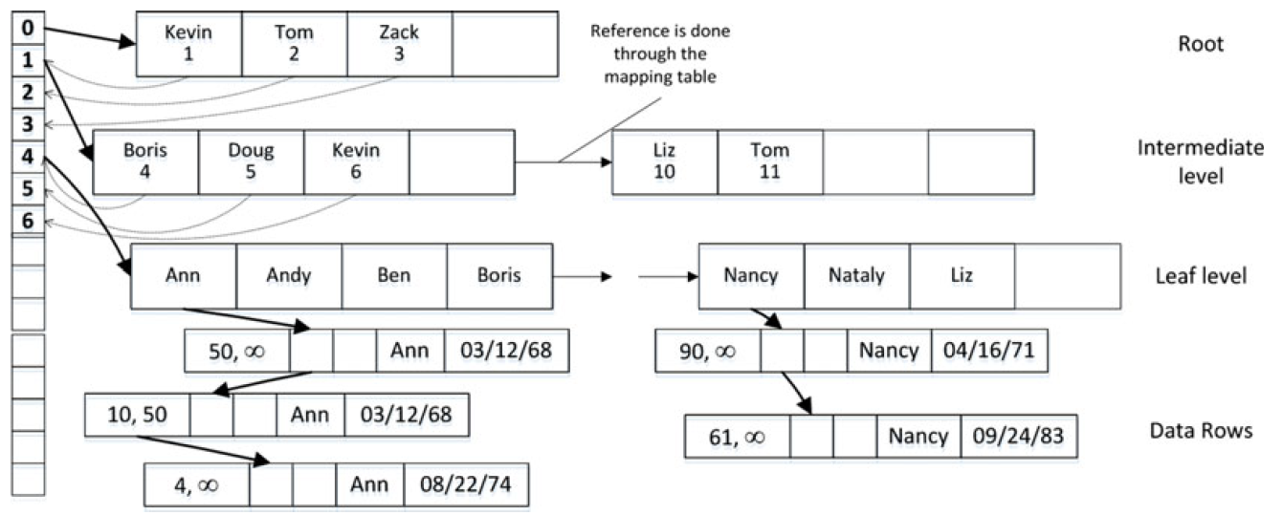
In-memory Bw-stabla
Range
Mapping table
Delta slogovi
No locks
No latches

Slide 9
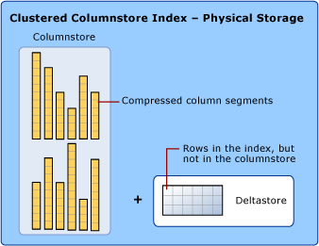
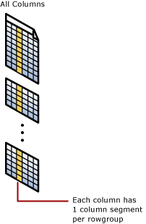
Columnstore indeksi
Data Warehouse sistem (OLAP)
OLTP => ETL => OLAP
Columnstore, rowgroup, column segment
Deltastore & delta rowgroup
Batch processing
create nonclustered columnstore index
IDX_FactSales_ColumnStore
on dbo.FactSales
(DateId, ArticleId,BranchId, Quantity, UnitPrice, Amount);

Slide 10
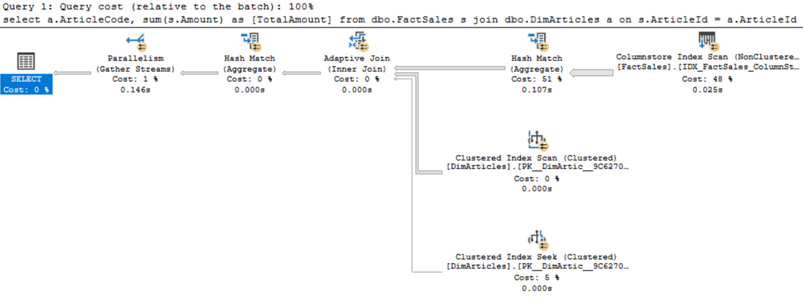
Columnstore indeksi
~10x brži upit

Slide 11
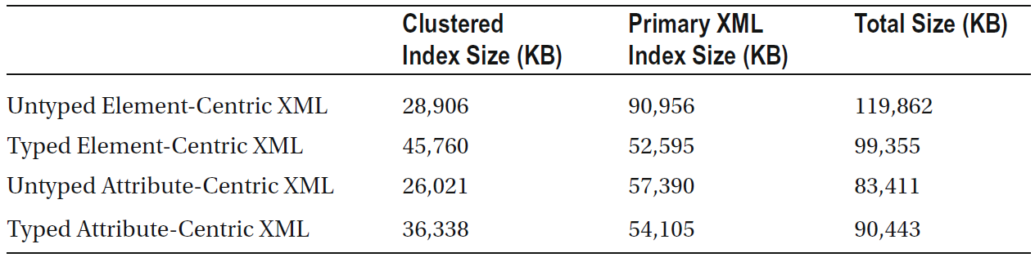
xml indeksi
Interni kompresovani UTF-16 format
Tipizirani i netipizirani
Primarni i sekundarni indeksi
Relactiona struktura

Slide 12
Prostorni indeksi
create table dbo.LocationsGeo
(
Id int not null identity(1,1),
Location geography not null,
constraint PK_LocationsGeo primary key clustered(Id)
);
create spatial index Idx_LocationsGeo_Spatial
on dbo.LocationsGeo(Location);
Tipovi
gemetry
geography
400% ubrzanje na primeru
-- Elfak
declare @g geography;
set @g = geography::Point(43.3267515, 21.8933164, 4326);
-- 5km within
select Id
from dbo.LocationsGeo
where Location.STDistance(@g) < 5000;

Slide 13
Tekstualni indeksi
Invertovani kompresovani indeks
Efikasnije od LIKE operatora
Širi jezički kontekst
Podrška za binarne datoteke
Grupisani unutar kataloga
Jedan po tabeli
CREATE UNIQUE INDEX ui_us_Customer
ON dbo.Customer(CustomerId);
CREATE FULLTEXT CATALOG ft AS DEFAULT;
CREATE FULLTEXT INDEX ON dbo.Customer (ShortBio)
KEY INDEX ui_us_Customer
WITH STOPLIST = SYSTEM;

Slide 14
Hvala na pažnji!

